Slide 1
5
th
DOT NET DAY
How to Integrate Azure OpenAI
& ML into .NET Core?

Slide 2
SPEAKER
TOPIC
How to Integrate Azure OpenAI
& ML into .NET Core?
Chintan J. Prajapati
CEO
Satva Solutions

Slide 3
Agenda
1. AI Accountant demo
2. Machine learning fundamentals
3. Model development using Auto ML
4. Azure OpenAI integration
5. Q & A

Slide 4
AI Accountant Demo
ML

Slide 5
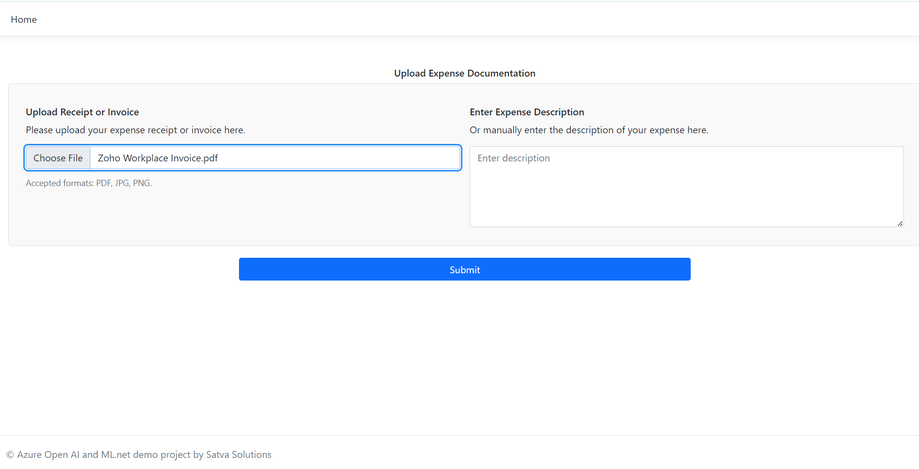

Slide 6
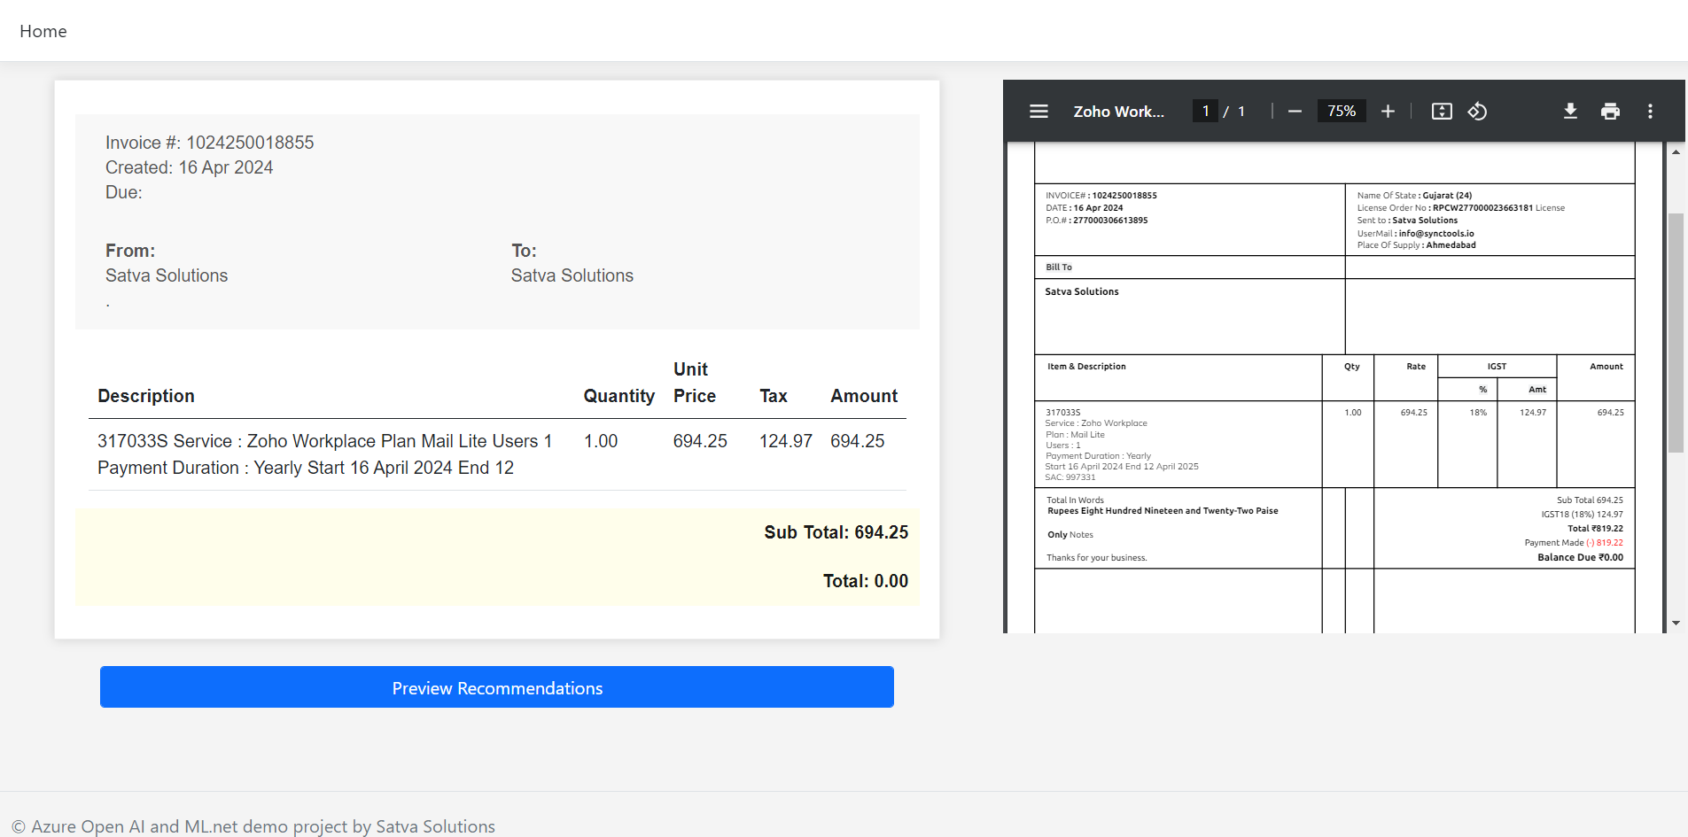

Slide 7
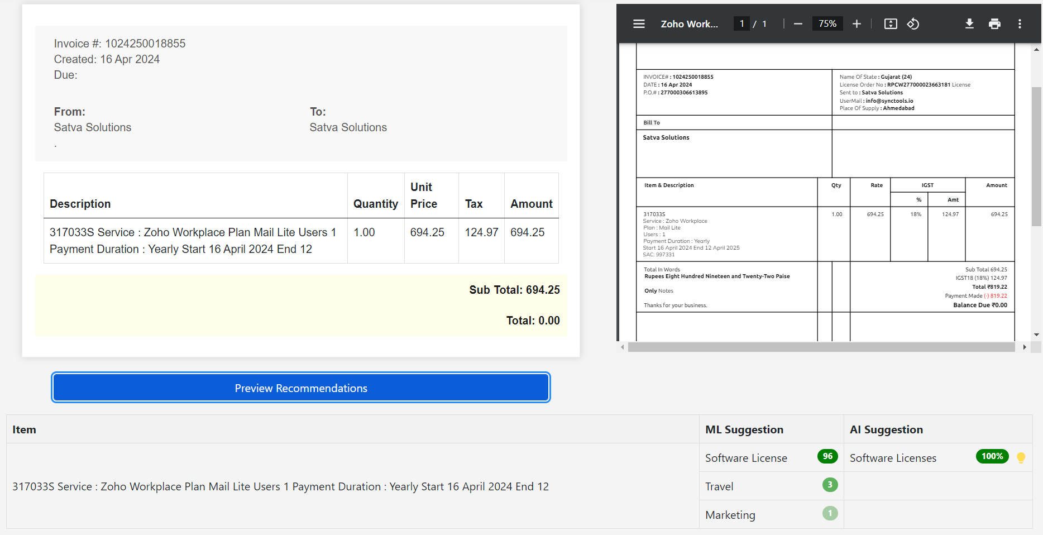

Slide 8
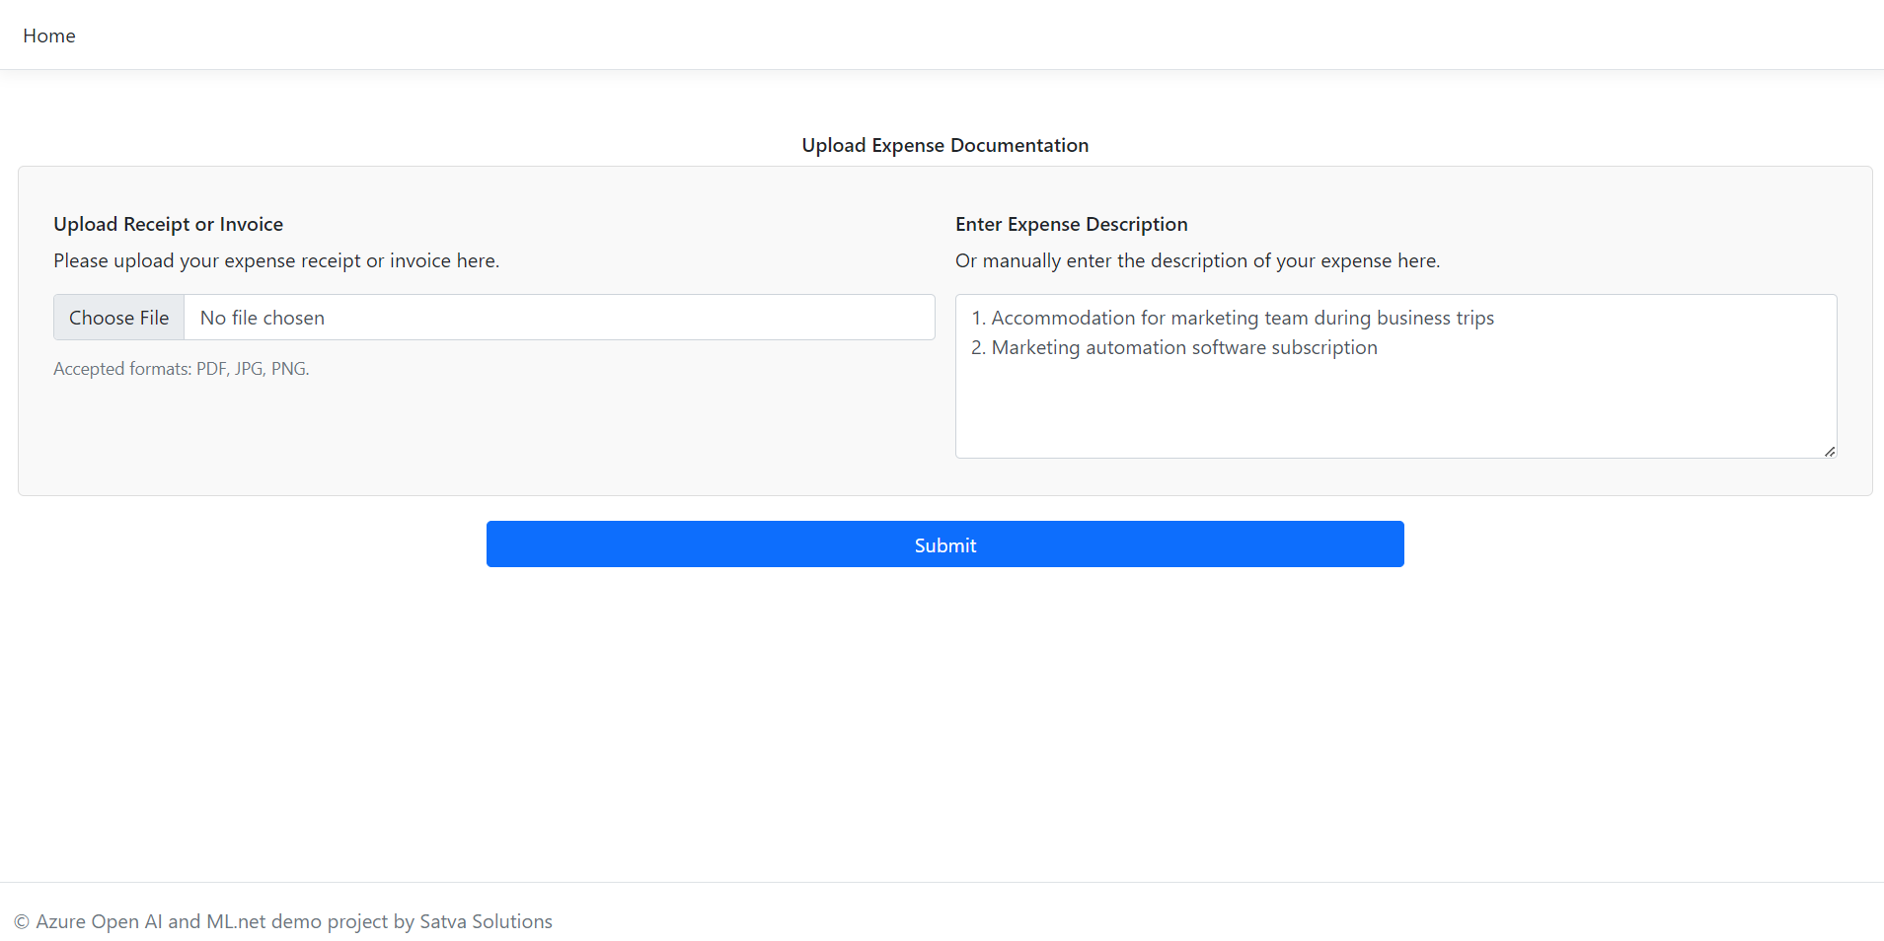

Slide 9
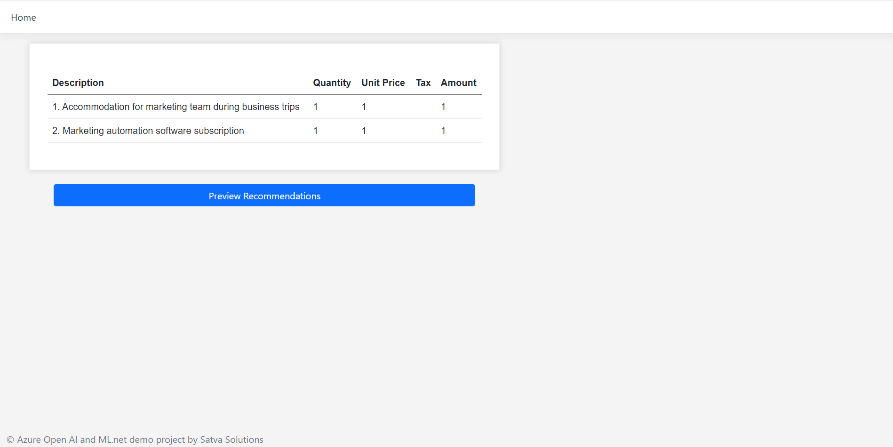

Slide 10
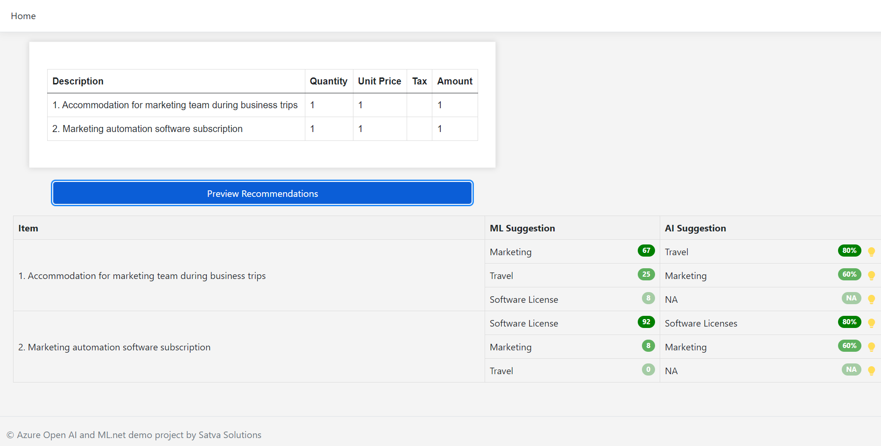

Slide 11
ML Fundamentals

Slide 12
What is GIGO?
Notes:
Garbage In Garbage Out

Slide 13
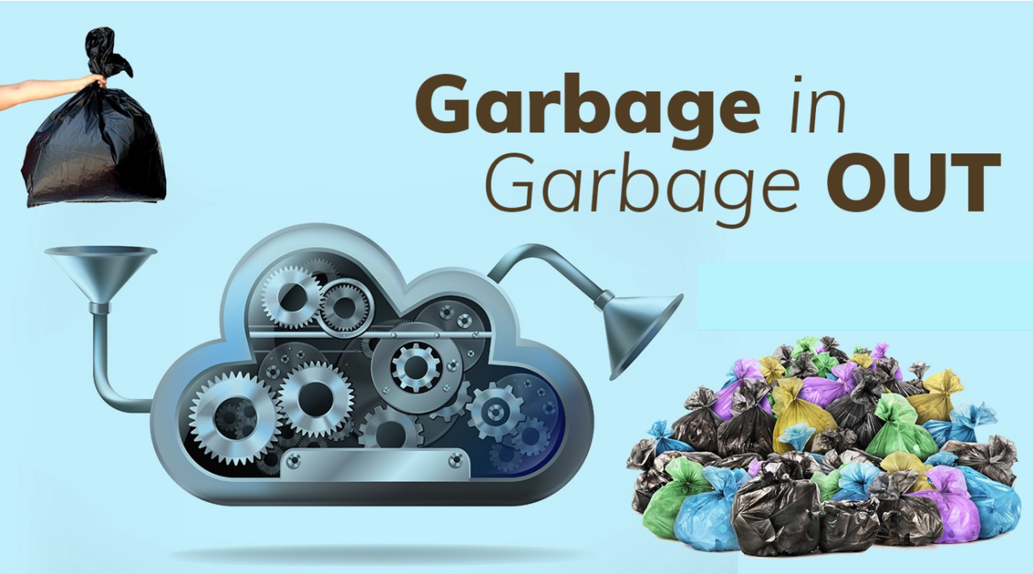
Notes:
Garbage In Garbage Out

Slide 14
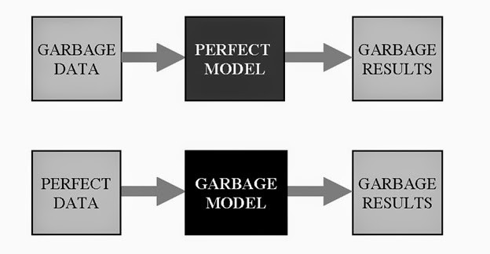

Slide 15
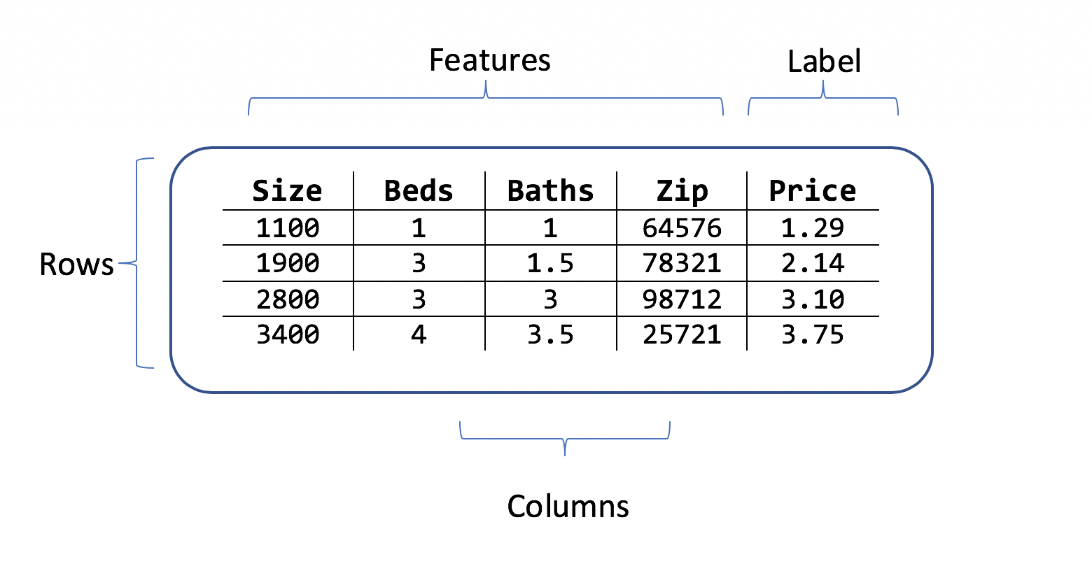
Dataset, Features, Labels
Notes:
A dataset is a collection of data that serves as the raw material for analysis, training, testing, and validating machine learning models
features are the data attributes, properties, or input variables based on which the model makes its predictions.
Labels are output variables that the model to is suppose to predict

Slide 16
ML Model development
process

Slide 17
Preprocessing
1. Data Cleaning
Removing Duplicates: Ensures no redundant data.
Handling Missing Values: Imputes missing values or removes rows/columns.
Outlier Detection: Identifies and handles data points which are significantly different from other observations, that could skew results.

Slide 18
Preprocessing
2. Data Transformation:
Normalization: convert word to lower text, remove punctuations, whitespace, stop words
Tokenization: breaking down sentences to words, subwords, characters
Vectorization: Converting tokens into numeric values

Slide 19
Example of normalization
 | Raw Data | Renewed - GitHub Enterprise, licenses; for development team. Total cost: $2000!
1 | Convert to Lowercase | renewed - github enterprise, licenses; for development team. total cost: $2000!
2 | Remove Punctuation ( - : , ; ) | renewed github enterprise licenses for development team total cost $2000
3 | Remove Special Characters $ , # % ^ | renewed github enterprise licenses for development team total cost 2000
4 | Remove Numbers | renewed github enterprise licenses for development team total cost
5 | Remove Stop Words | renewed github enterprise licenses development team total cost
6 | Eliminate word suffixes like ing, ed (i.e stemming ) | renew github enterpris licens develop team total cost
7 | Reduce words to its base or root (lemmatization ) | renew github enterprise license develop team total cost

Slide 20
ML.NET methods for normalize
 | Transform | Description | Result
1 | NormalizeText | Converts all letters to lowercase by default | this is a good product
2 | TokenizeWords | Splits string into individual words | ["this","is","a","good","product"]
3 | RemoveDefaultStopWords | Removes stop words like is and a. | ["good","product"]

Slide 21
example of featurization
 | Transform | Description
1 | Normalized Data | renew github enterprise license develop team total cost
2 | Tokenized Array | ["renew", "github", "enterprise", "license", "develop", "team", "total", "cost"]
3 | MapValueToKey | [1, 2, 3, 4, 5, 6, 7, 8]
4 | ProduceNGrams 2-grams | ["renew github", "github enterprise", "enterprise license", "license develop", "develop team", "team total", "total cost"] [[1, 2], [2, 3], [3, 4], [4, 5], [5, 6], [6, 7], [7, 8]]
5 | Feature Vectors (NormalizeLpNorm) | [ 0.2041241, 0.3881241, 0.4472136, 0 , … ]

Slide 22
NormalizeLpNorm vectors
Notes:
L2-norm will perform Square root of the sum of squared values.

Slide 23
How to create ML model using Model Builder(Auto ML) ?

Slide 24
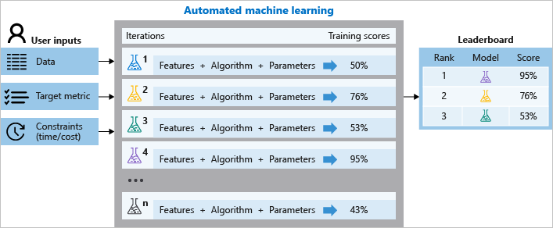
Notes:
Automated ML is the process of automating the time-consuming, iterative tasks of machine learning model development. It allows developers to build ML models with high scale, efficiency, and faster..

Slide 25
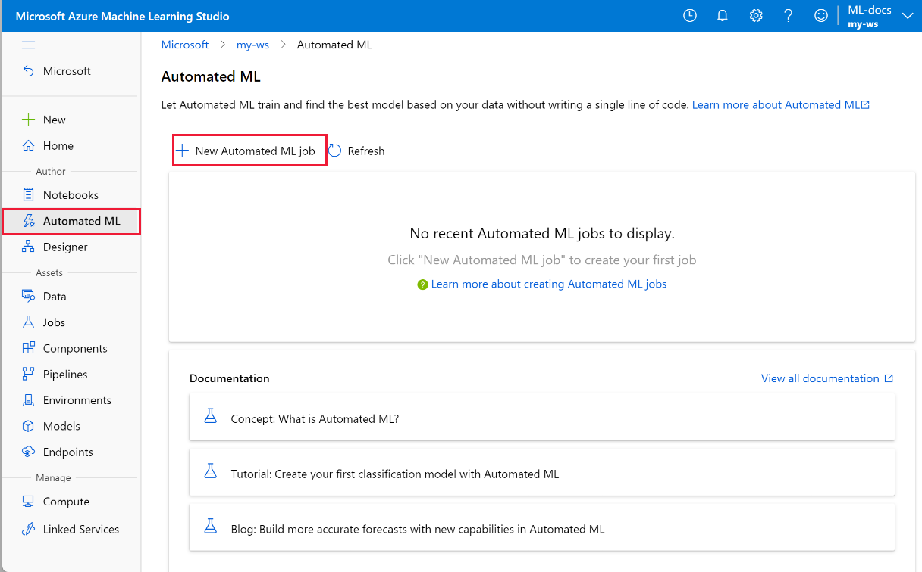
Notes:
Two options 1 ) Use GUI 2) no-code i.e use azure ML studio in browser

Slide 26
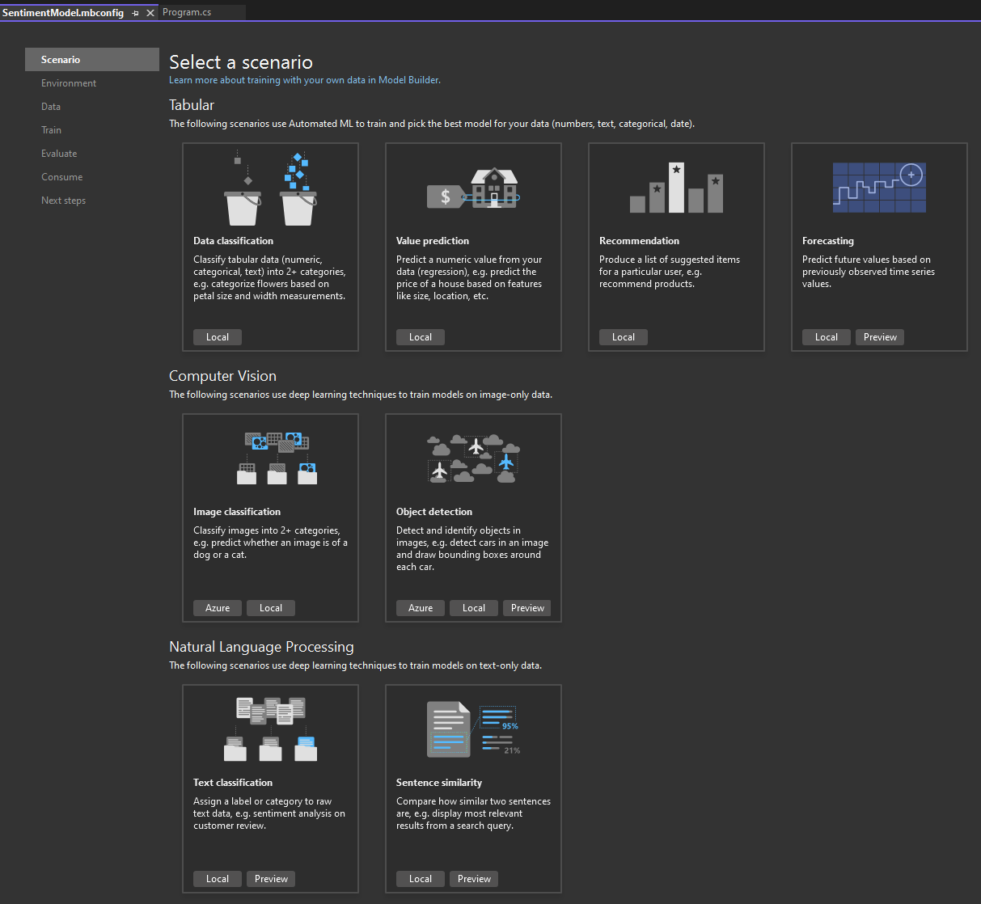
Notes:
Two options 1 ) Use GUI 2) no-code i.e use azure ML studio in browser

Slide 27
Auto ML handles 4 stages

Slide 28
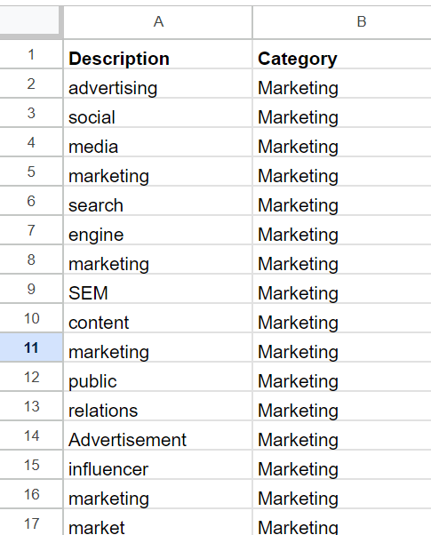
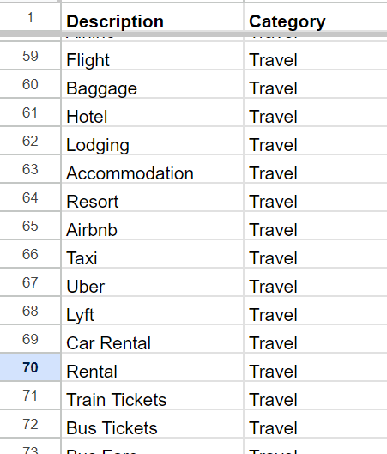
Expense Dataset
100 Records Created Manually across 9 categories
Quality of data is good
Quantity of data is too less
Leads to Underfitting
dataset is too simple
for Auto ML to figureout
underlaying patterns

Slide 29
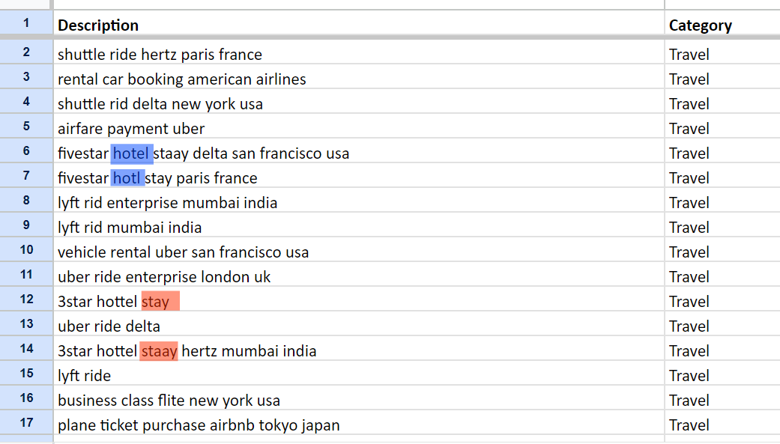
Expense Dataset
5000+ Rows
across 3 categories
Generated realistic data with
vendor names
spelling mistakes
locations

Slide 30
Create Model using Auto ML
in Visual Studio
Live demo

Slide 31
code for normalizing data
Notes:
var mlContext = new MLContext();
var data = mlContext.Data.LoadFromTextFile<InputData>(dataPath, hasHeader: true, separatorChar: ',');;
var pipeline = mlContext.Transforms.Text.NormalizeText("NormalizedExpenseDescription", "ExpenseDescription", keepPunctuations: false)
.Append(mlContext.Transforms.Text.TokenizeIntoWords("Tokens", "NormalizedExpenseDescription"))
.Append(mlContext.Transforms.Text.RemoveDefaultStopWords("NoStopWords", "Tokens"))
.Append(mlContext.Transforms.Conversion.MapValueToKey("Values", "NoStopWords"));
var preview = pipeline.Fit(data).Transform(data).Preview();

Slide 32
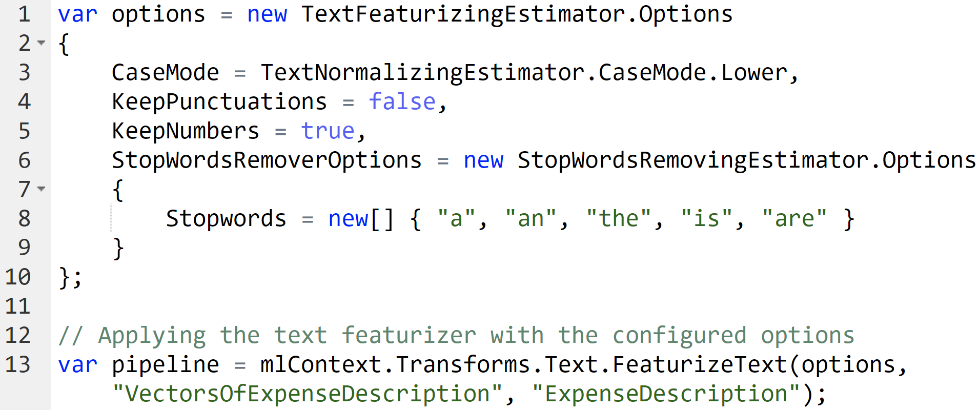
code for featurize
Notes:
var options = new TextFeaturizingEstimator.Options
{
CaseMode = TextNormalizingEstimator.CaseMode.Lower,
KeepPunctuations = false,
KeepNumbers = true,
StopWordsRemoverOptions = new StopWordsRemovingEstimator.Options
{
Stopwords = new[] { "a", "an", "the", "is", "are" }
}
};
// Applying the text featurizer with the configured options
var pipeline = mlContext.Transforms.Text.FeaturizeText(options, "FeaturizedExpenseDescription", "ExpenseDescription");
Ref: https://learn.microsoft.com/en-us/dotnet/api/microsoft.ml.textcatalog.featurizetext?view=ml-dotnet

Slide 33
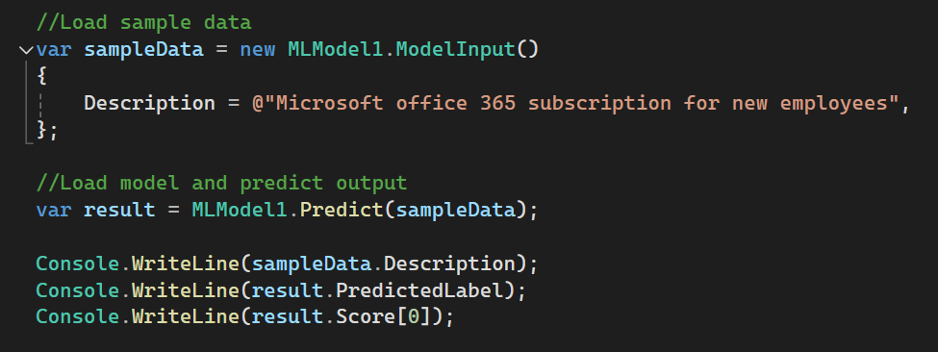
code for predicting labels
Notes:
//Load sample data
var sampleData = new MLModel1.ModelInput()
{
Description = @"Microsoft office 365 subscription for new employees",
};
//Load model and predict output
var result = MLModel1.Predict(sampleData);
Console.WriteLine(sampleData.Description);
Console.WriteLine(result.PredictedLabel);
Console.WriteLine(result.Score[0]);

Slide 34
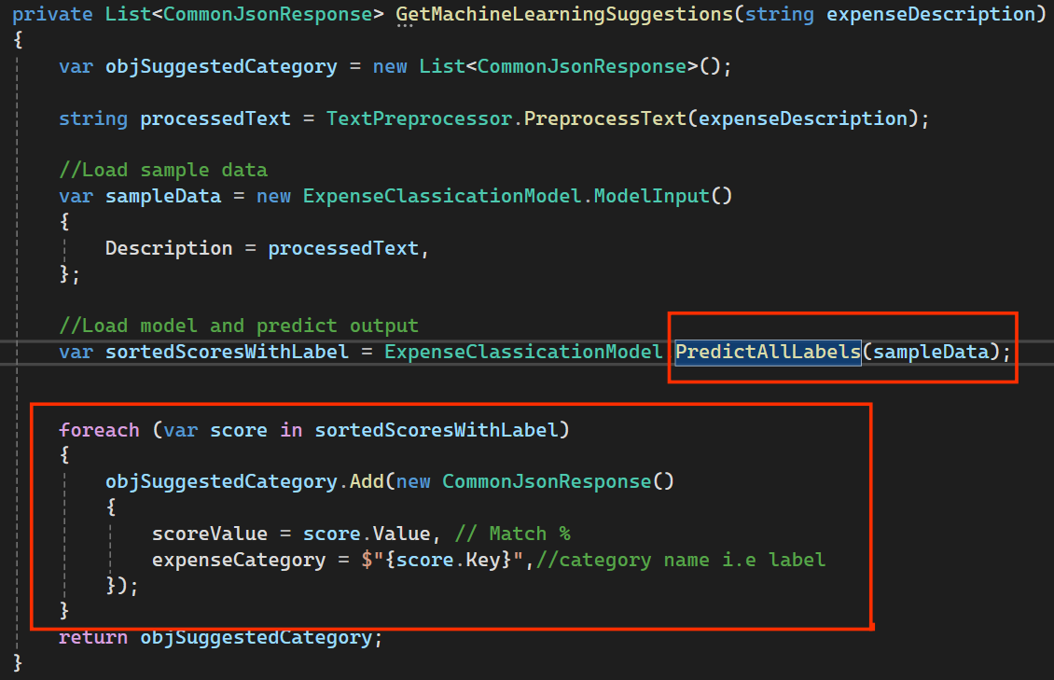
code for predicting all labels

Slide 35
How to integrate Azure Open AI ?
Notes:
before we understand how to integrate, let’s unders why to use Azure open ai ? instead of Open AI directly.

Slide 36
Azure Open AI vs Open AI
Feature | OpenAI Services | Azure OpenAI Services
Data Privacy Policy | Data samples may be used for model training unless opted out. | Data is not used for training without explicit customer consent.
Integration | Standalone platform with API access. | Integrated with Azure ecosystem
Security | General security measures in place. | Enterprise-grade security with Azure AD (Entra ID), compliance with industry standards.
Compliance | Basic compliance standards. | Meets various industry standards (GDPR, HIPAA, etc.). Keep your data in your country.
Availability | Immediately | Limited , subject to approval due to Responsible AI initiative

Slide 37
Prerequisites
Azure subscription.
Submit an application to access Azure OpenAI Service. To apply for access, complete this form.
Create Azure Open AI resource

Slide 38
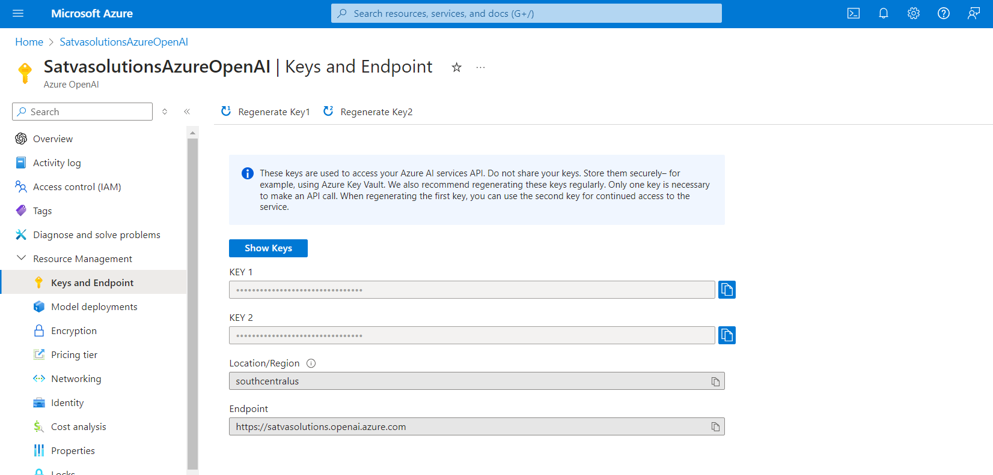

Slide 39
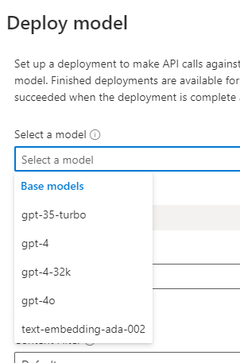

Slide 41
Notes:
Chat: Context aware multi-turn conversations with role-based messaging. System,User and Assistant Role. Best for chatbots.
Completion: General-purpose text generation based on a single prompt. Ideal for content generation, summarization, classification
Assistant: combining elements of both Chat and Completion.The advantage of the assistant API is that it automatically handles the token limits for the given model and auto-truncates messages.
where as for chat we need to handle to limits of token by removing old user user and assistant messages from chat history.

Slide 42
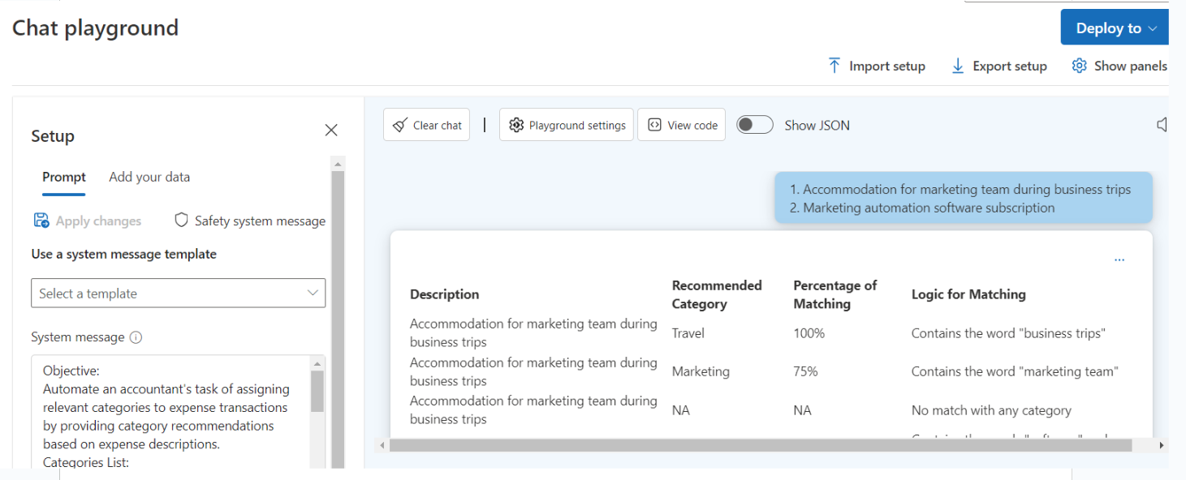
Notes:
Look at the system message
User message
Assistant message / completion

Slide 43
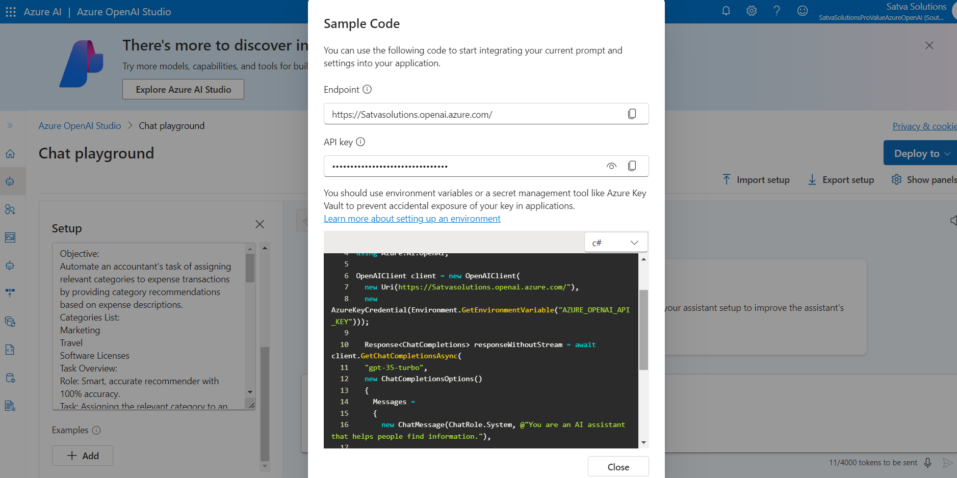

Slide 44
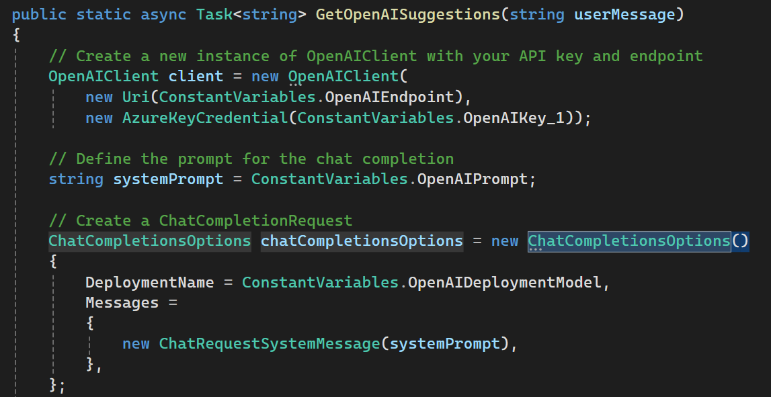
code for chat completion api

Slide 45
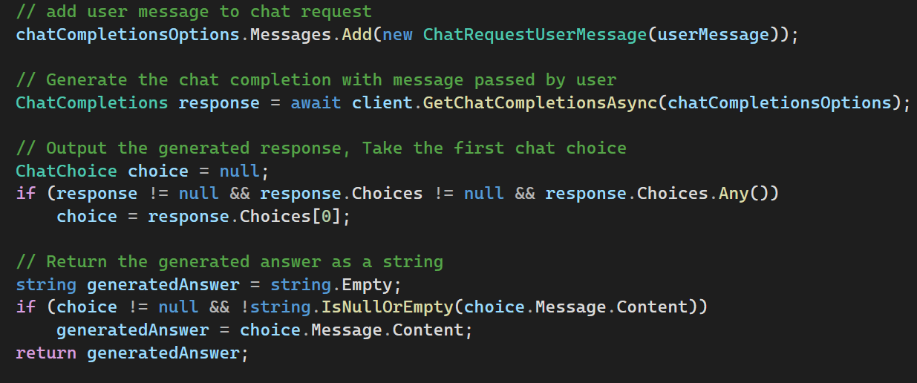
code for chat completion api

Slide 46
Azure Open AI Prompt Structure
Objective: Automate an accountant's task of assigning relevant categories to expense transactions by providing category recommendations based on expense descriptions.
Categories List:
Marketing
Travel
Software Licenses

Slide 47
Azure Open AI Prompt Structure
Task Overview:
Role: Smart, accurate recommender with 100% accuracy.
Task: Assigning the relevant category to an expense description
Provide Recommendations:
Given the expense description, recommend three top categories.
each expense description should have its own set of three category recommendations, with no repetition of category for each expense description
When multiple expense description inputs are provided by the user, the system should generate three relevant category recommendations for each input expense description.
Even if a description is deemed completely irrelevant or junk, the system will still produce an output, marking the recommendations as "NA."

Slide 48
Azure Open AI Prompt Structure
Output format will be Table with the following columns:
Description
Recommended Category
Percentage of Matching
Logic for Matching

Slide 49
Azure Open AI Prompt Structure
The output will consist solely of a table containing relevant values; descriptions outside the table will not be included.
Example Output:
Description | Recommended Category | Percentage of Matching | Logic for Matching
[Input Expense Description 1] | [top matching Category] | [Percentage] | [Reason]
[Input Expense Description 1] | [second matching Category] | [Percentage] | [Reason]
[Input Expense Description 1] | [third matching Category] | [Percentage] | [Reason]
Inputs expense descriptions
Adobe Creative cloud license
Microsoft Office 365 License
Uber texi

Slide 50
Useful resources
Top websites for open source dataset & models
UCI Machine Learning Repository contains dataset for machine learning training
data.world 130825 open data datasets available
Kaggle Open source dataset and pre trained models available
Top websites for Synthetic data degeneration
Mockaroo Free tool for unlimited data generation from browser
gretel.ai Paid tool with free trial credits.
mostly.ai Paid tool with Daily free credits
Chatgpt prompts for data generation
ChatGPT Classification Prompt works with gpt 3.5 & 4o both.
https://chatgpt.com/share/88f69361-3dc7-45a9-8159-a7e8360b2c73 500 rows Realistic data generator prompt

Slide 51
Useful resources
Links
Download modal builder extension from VS marketplace https://marketplace.visualstudio.com/items?itemName=MLNET.ModelBuilder2022

Slide 52
SPONSORS
THANK YOU
Stay Tuned For Next Dot Net Day

